Slide 1


BREAKOUT ROOM · OPERATIONAL EFFICIENCY
Keeping the lecturer
in the loop
with [name], Eduface

Slide 2



THIS ROOM
Three parts
Vote on
five statements
How we keep the lecturer
in the loop
Discussion
2

Slide 3
STATEMENT 1 OF 5
Formative feedback that no lecturer has read first is acceptable.
Agree
Disagree
3

Slide 4
STATEMENT 2 OF 5
Time saved on marking would go back into teaching at my institution.
Agree
Disagree
4

Slide 5
STATEMENT 3 OF 5
Most lecturers would accept AI feedback without changing it.
Agree
Disagree
5

Slide 6
STATEMENT 4 OF 5
Students care whether a person wrote their feedback.
Agree
Disagree
6

Slide 7
STATEMENT 5 OF 5
Summative feedback should always be signed off by a lecturer.
Agree
Disagree
7

Slide 8
Demo
Human in the loop
How the lecturer stays in charge of summative feedback
8

Slide 9



SUMMATIVE FEEDBACK
The AI drafts.
The lecturer decides.
→
→
AI drafts a comment
per rubric criterion
Lecturer reads,
edits and adds
Only approved feedback
reaches the student
Lecturer + AI
Every comment is reviewed before the student sees it.
9

Slide 10
WHAT WE SEE
97%
Lecturers don’t outsource their judgement.
They work with the AI to give the student better feedback.
of summative assignments get
extra feedback from the lecturer,
on top of the AI draft
Eduface platform data, summative assessments.
10

Slide 11
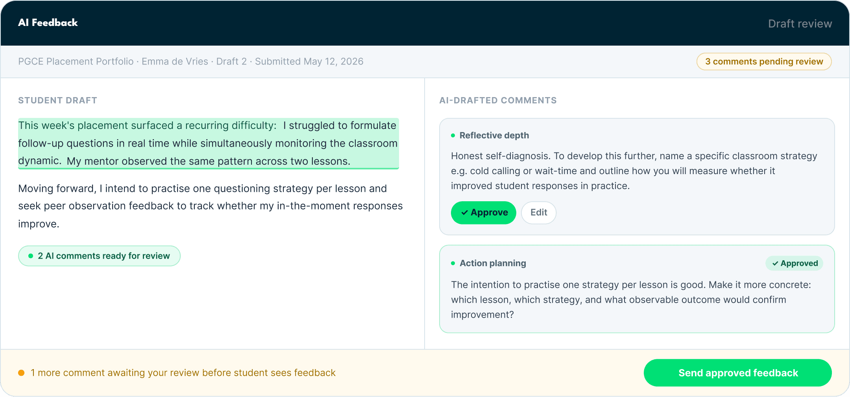
WHAT THE LECTURER SEES
Every comment waits
for approval
Approve, edit or add.
Nothing goes to the student
without the lecturer.
Product screen from eduface.me
11

Slide 12
AN IDEA WE’D LIKE YOUR VIEW ON
A nudge against
rubber-stamping
✓
✓
✓
✓
✓
✓
✓
✓
✓
✓
?
10 approved without a single change.
Take a closer look at this one?
When a lecturer approves a long run of drafts untouched,
the platform asks them to look again.
Concept for discussion, not a current feature.
12

Slide 13
Live demo
One assignment, from AI draft to approved feedback.
13

Slide 14
DISCUSSION
What should a lecturer
always add that AI can’t?
The 97% says lecturers already know.
14

Slide 15
DISCUSSION · 1 OF 4
What does “human in the loop” mean at your institution in practice?
15

Slide 16
DISCUSSION · 2 OF 4
When is approving without edits fine, and when is it a warning sign?
16

Slide 17
DISCUSSION · 3 OF 4
Who is accountable for summative feedback: the lecturer, the module lead or the institution?
17

Slide 18
DISCUSSION · 4 OF 4
Where would you spend the time you get back?
18

Slide 19
Back to the
main room
Bring one thing you heard here.

